Slide 1
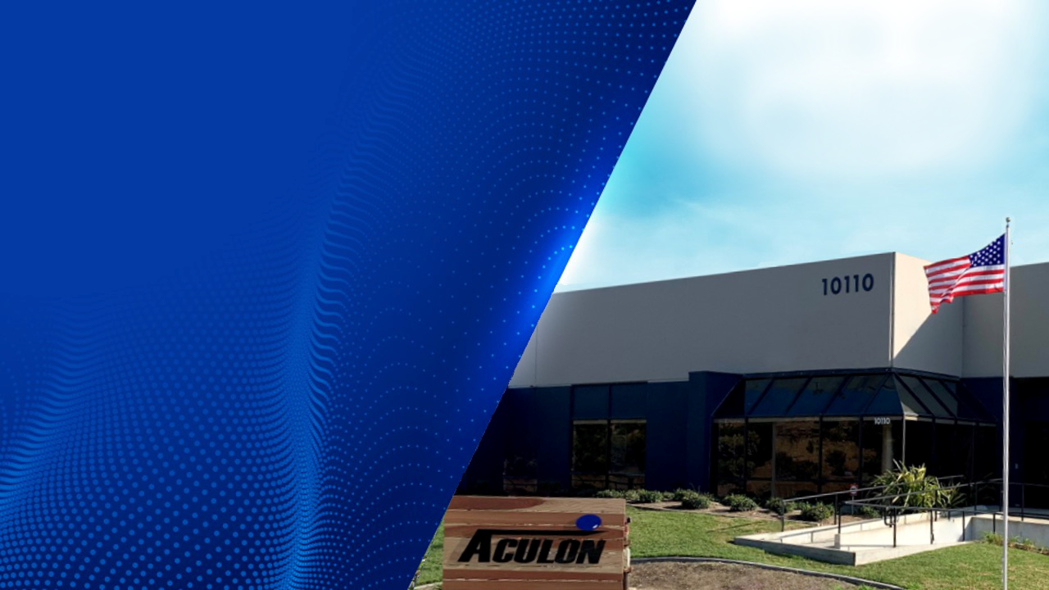
NanoProof® 3 Series
3M™ Novec™ Engineered Grade Coatings Replacement
www.aculon.com
Aculon® Confidential Information

Slide 2
AGENDA
AGENDA
Introduction
NanoProof® Overview
NanoProof 3 Series -3M™ Product Comparison (1700, 1900, 2700)
Summary
Questions & Discussion

Slide 3
OUR GOAL
Aculon® uses its expertise in surface modiﬁcation technologies to enable customers to make better products by being fast, innovative & responsive.
Together we create winning products!

Slide 5
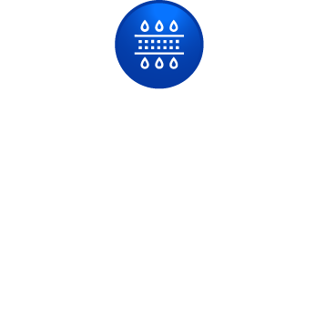
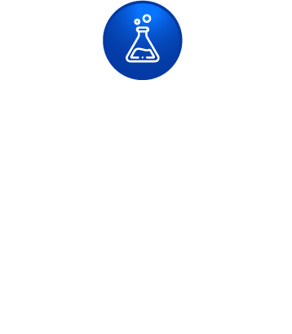
ACULON® OVERVIEW- Founded in 2004
Founded 2004
Expertise
Develop & produce surface solutions to modify a broad variety of surfaces (metals, metal oxides, ceramics, glass, polymers)
Functionality
Hydrophobic, superhydrophobic, oleophobic, hydrophilic, oleophilic anti-ﬁngerprinting, adhesion promotion
Treatments
Thin, easy to apply (no vacuum chambers),
often no cure, safe, non-toxic, and offer green & VOC exempt options.
-Over 100 Products
Focus areas
Electronics,
Oil & Gas,
Medical,
Specialty
Business Model
Optimize custom surface treatment solutions, produce and sell treatment chemistry, treat parts for customers if required
-ISO 9001
Knowledge
- >40 Patents granted.
-Invested 100,000’s hours on 1000’s projects.
-Smart (numerous Chemists with PhD’s & Masters Degrees, Electrical & Mechanical Engineers)
Differentiation
Create proprietary innovative treatments & willingness to work with customer to solve problems
Global
Locations
San Diego (HQ, Lab & Manufacturing),
Shanghai, Singapore, Dusseldorf, Amsterdam, Dallas, Houston
Distributors

Slide 6
MANY SURFACE MODIFICATION PLATFORMS
Transition Metal Complexes
Polymeric Organometallics
Oleophilic
Self Assembled Monolayers of Phosphonates
(SAMPs)
Surface Polymer Growth
Hydrophilic
Organometallic

Slide 7
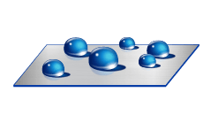
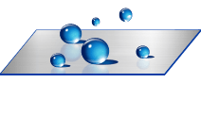
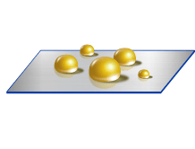
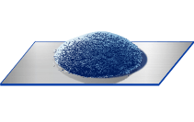
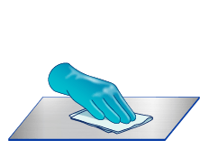
BROAD PORTFOLIO
PRODUCT GROUPS
FUNCTIONALITIES
Repellency treatments
Hydrophobic
Attraction treatments
Superhydrophobic
Anti Fingerprinting Treatments
Oleophobic
Surface Primers
Hydrophilic
Waterprooﬁng Treatments
Superhydrophilic
Hard Coats
Anti-ﬁngerprinting
Surface Cleaners
Adhesion promotion

Slide 8
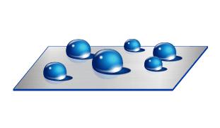
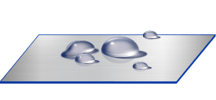
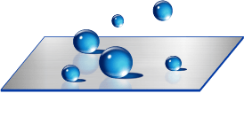
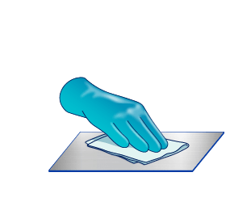
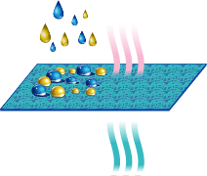
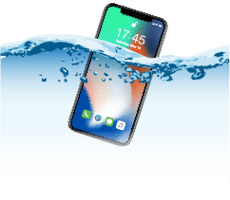
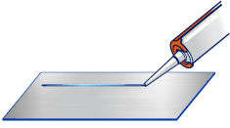
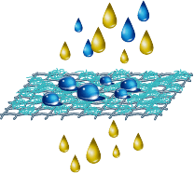
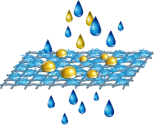
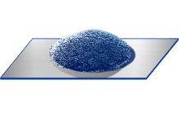
ACULON SURFACE PROPERTIES ADJUSTMENTS AT A GLANCE:
Aculon Treatment Examples
Untreated Surface
Hydrophilicity
Oleophobicity
Hydrophobicity & Super-Hydrophobicity
Application Examples:
Easy Clean & Anti-Fingerprint
(Electronics)
Waterprooﬁng
Adhesion Promotion
Particle Treatment
Membranes Treatment
ACULON – BECAUSE SURFACES MATTER!

Slide 9
EXPERTISE AND PLATFORMS
Anti-Fouling
Medical
Barrier protection (Electronics & Automotive)
Membranes
Surface Modiﬁcation
Anti- Fingerprinting
Metal Treatment (Electronics & Industrial)
Enhanced Oil Recovery

Slide 10
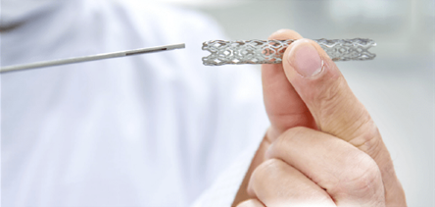
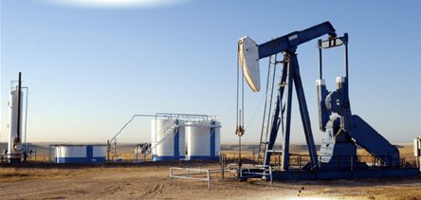
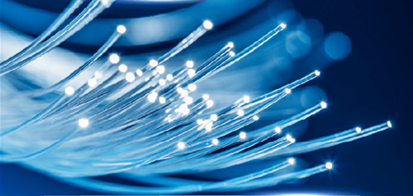
ACULON® FOCUSES
Electronics
Medical
Energy
Specialty - Other

Slide 11
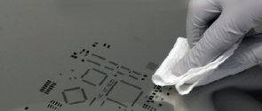
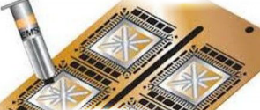
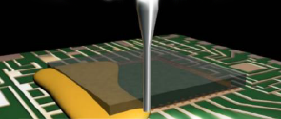
ELECTRONICS
NanoProof®
Electronics Protection
NanoClear®
SMT Stencil Nano-Coating
Anti-FingerPrint Coatings
Hide appearance of prints
Adhesion Promotion
Improve Bond Strength
Epoxy & Underﬁll Control
Prevent adhesive ﬂow out
Test Pin Repellency Coatings
Increase Test Pin Lifetime

Slide 12
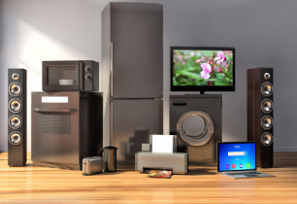
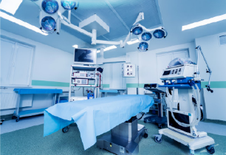
ELECTRONICS PROTECTION
In real life, electronic devices are often damaged
Device dropped in pool or even toilet
Household appliances exposed water during operations
Unit exposed to outdoor
environment – dust, rain, humidity
Equipment (industrial and medical) exposed to dirty and wet working environment

Slide 13
NANOPROOF® ELECTRONICS PROTECTION
Award winning liquid applied electronics protection technology
Aculon® NanoProof® Series launched in 2010 provides protection from dust & humidity all the way to full water immersion
Utilize proprietary technology
Application equipment affordable and readily available
Range of treatments available to meet IPX3 to IPX8.
Aculon technology used on over 1 million EV’s

Slide 14
CURRENT NANOPROOF® SERIES FEATURES
NanoProof® Series | IPX | In-Line | Non-Toxic | Push Through | Flexible | Green/VOC Exempt*
1 | 3
5 | 5
8 | 8
X | 8
12 | 8
15 | 8
* Conforms with US EPA or China regulations

Slide 15
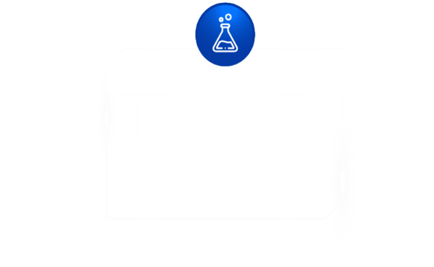
NANOPROOF® ADVANTAGES
Continuous Process
Eliminate slow & cumbersome batch deposition solutions
Flexible liquid solutions include dip, spray, & dispense
Uniform & Protects Edges
Consistent coverage across all components with no slumping, even edges.
Eliminate failures due to non-uniform edge coverage
Easy Application
Reduce process time with on target & uniform thickness in one / two passes.
Eliminate time consuming vac dep or multiple application passes for target thickness
Coat Connectors
Push Through Connectivity allows for protection of sensitive connection components.
Eliminate masking and mechanical gasketing previously required.
Thin & Tight Tolerance
IPX8 as thin as 30uM suitable for extremely tight tolerance applications.
Selective application protects sensitive components close to “keep out” areas.
Performance & Electrical Isolation
Industry leading electrical isolation.
IPX8 level performance with minimal material utilization.

Slide 16
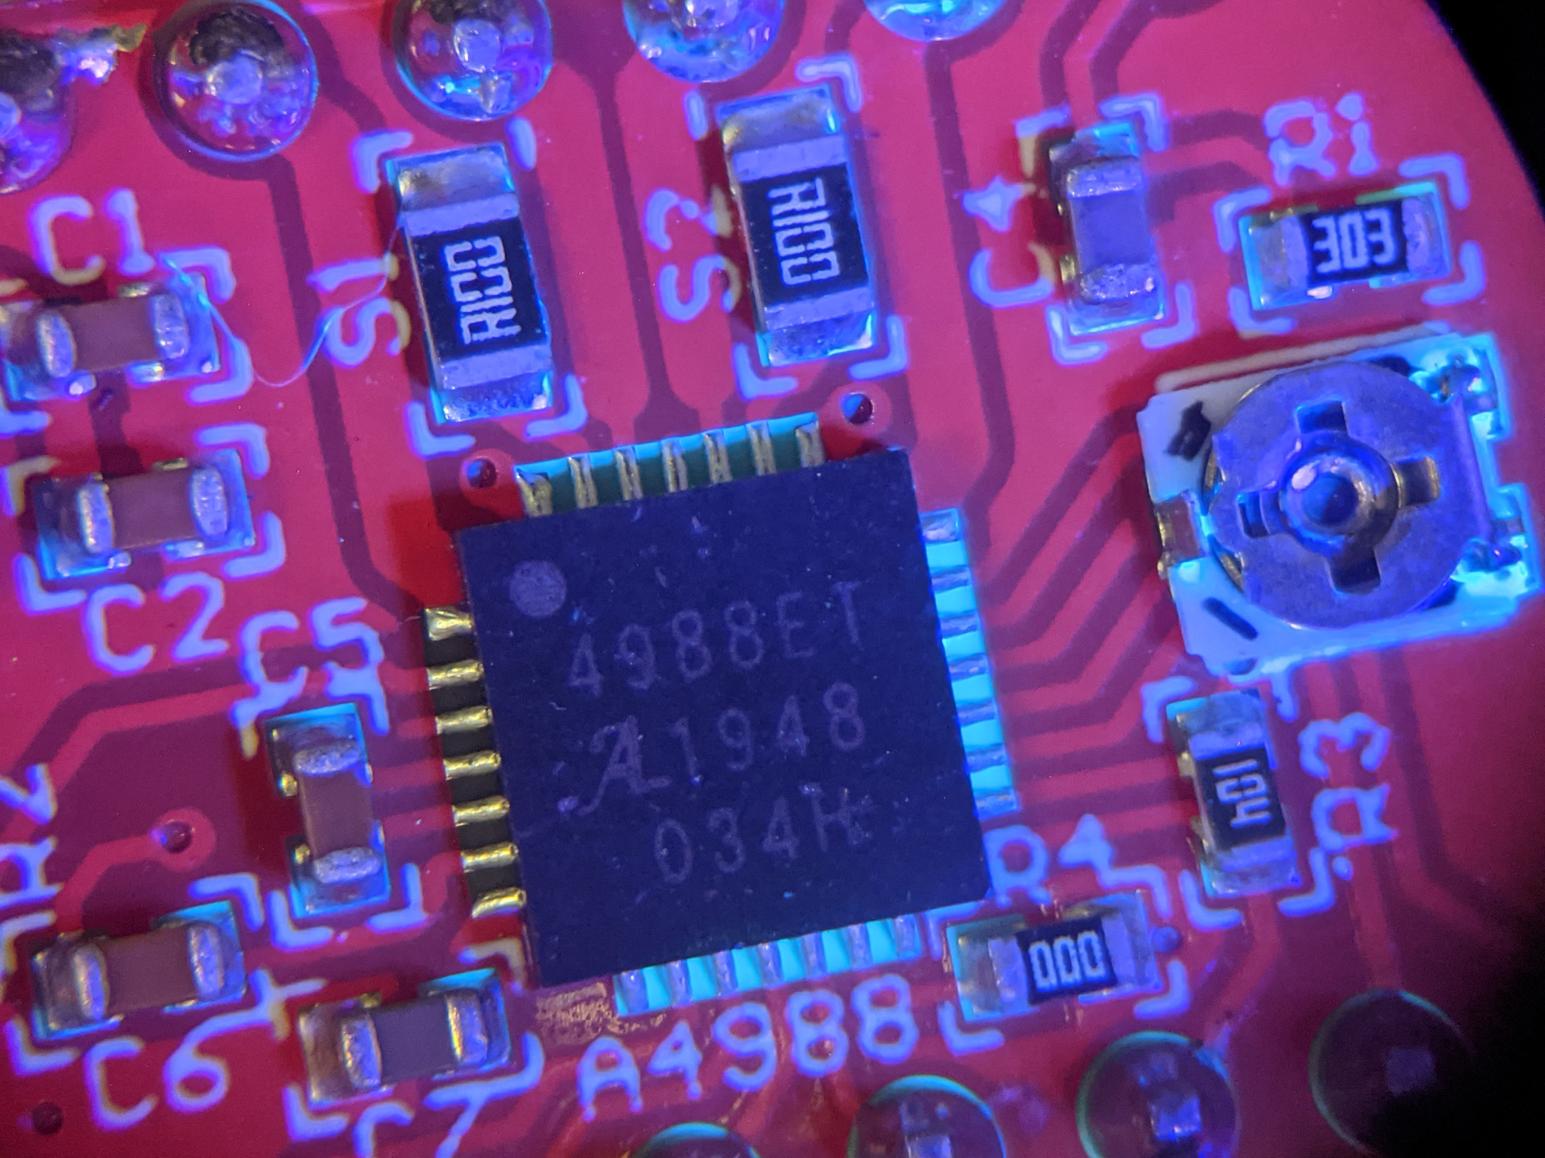
NanoProof® 3 series offers direct replacements to 3M™ Novec™ products.
INTRODUCING NANOPROOF® 3 SERIES
NanoProof® 3 series offers anti-wetting, anti-stiction, chemical protection, corrosion protection, and moisture protection for PCBs and electrical components.
NanoProof® 3 Series benefits
“Drop-in replacement”
Offered through distributors
Contains UV tracer
Cost effective and in many cases lower cost

Slide 17
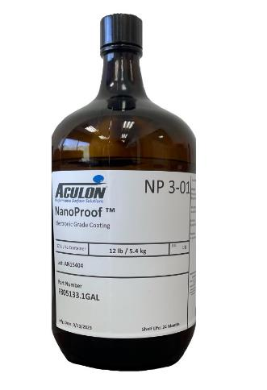
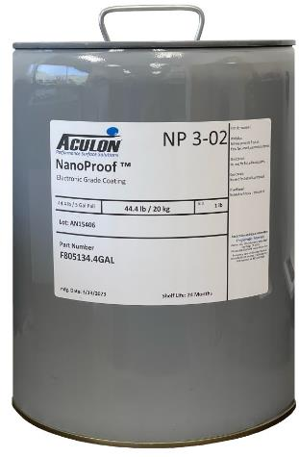
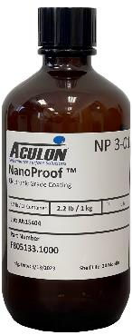
PACKAGING
40 mL
1 Liter
1 kg
1 Gallon
5.4 kg
4 Gallon
20 kg

Slide 18
NANOPROOF 3 - TECHNOLOGY APPLICATION
NANOPROOF® 3 – NOVEC™ REPLACEMENTS
3M™ Novec™ Product | NanoProof® Alternatives
 | NanoProof® 3-01
3M™ Novec™ 1700 | NanoProof® 3-02
3M™ Novec™ 1702 | NanoProof® 3-002
3M™ Novec™ 1710 | NanoProof® 3-10
3M™ Novec™ 1720 | NanoProof® 3-001X –(LEDs)
3M™ Novec™ 1902 | NanoProof® 3-02
3M™ Novec™ 1904 | NanoProof® 3-04
3M™ Novec™ 1908 | NanoProof® 3-08
3M™ Novec™ 2704 | NanoProof® 3-04
3M™ Novec™ 2708 | NanoProof® 3-08
3M™ Novec™ 7100 | Aculon® 3 Series-Extender

Slide 19
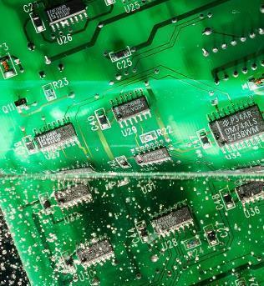
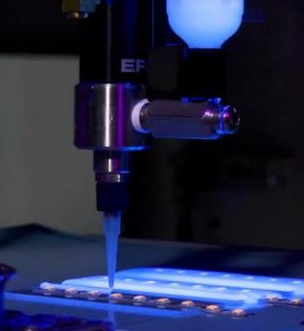
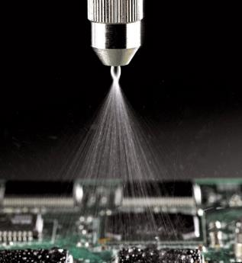
NANOPROOF® 3 – TECHNOLOGY APPLICATION
Flexible coating processes make conversion easy to implement.
Dip
Dispense
Spray

Slide 20
NANOPROOF® 3 vs NOVEC™ 1700 SERIES
 | 1700 | 1702 | 1710
Solids | Fluoroacrylate 2% | Fluoroacrylate 0.2% | Fluoroacrylate 10%
Solvent | 7100DL
Appearance | Clear
Density | 1.5 g/mL
Viscosity | 0.91 cP | 0.63 cP | 4.3 cP
Boiling Point | 61°C
Flash Point | None
Environmental | Non-ozone depleting, low in toxicity, low in GMP, RoHS compliant and VOC exempt (per US EPA), contains no chlorine or bromine
Shelf Life | 4 yrs in unopened package from manufacture date
Thickness | 0.1-1 µm | <100 nm | 0.1-1 µm
Chem Resistance | Resists a variety of solvents/chemicals, dissolves in acetone
Tg | 44°C
Therm. Stability | 175°C for 24 hours
Contact Angles | WCA / OCA: 105° / 65°
Refractive Index | 1.39
Solder Thru Repairability | Yes
Non-Flammability | Meets UL 94 V-0
Coef. of Therm. Expn. | 70 µm/(m·°C)
Therm. Cond. | 0.1 W/m*K
Diel. Bd Strength | 2000 V/mil
Cure | None
Removable | Yes
3-02 | 3-002 | 3-10
Fluoroacrylate 2% | Fluoroacrylate 0.2% | Fluoroacrylate 10%
Aculon 3 Series Exyender
Light Green
1.5 g/mL
<20 cP
In process, 56-61°C estimate
None
Non-ozone depleting, low in toxicity, low in GMP, RoHS compliant and VOC exempt (per US EPA), contains no chlorine or bromine
2 yrs in unopened package from manufacture date
0.2-2 µm | 0.1-1 µm | 0.25-6 µm
Resists a variety of solvents/chemicals. Attacked by fluorosolvents and ketones
~95°C from peak on DSC
Stable in 175°C for 24 hours
WCA / OCA: 120° / 80°
n=1.376 @ 632.8 nm
Yes
Meets UL 94 V-0
In Process
In Process
3600 V/mil
None
Yes

Slide 21
ACULON® FS-Extender vs NOVEC™ 7100
 | 7100
Viscosity | <5 cP
Boiling Point | 61°C
Freezing Point | -135°C
Flash Point | None
Specific Gravity | 1.52 g/mL
Shelf Life | 2 yrs (unopened container)
3 Series-Extender
<1 cP
TBD, Estimate 56-61°C
<-81°C
None
1.5 g/mL
2 yrs (unopened container)

Slide 22
FAQ
How durable is the coating? | Safe for handling but not abrasion resistant.
What is the targeted thickness? | Target thickness is application dependent.
How can NanoProof 3 be applied? | NanoProof 3 can be dipped, sprayed, and needle dispensed.
Is NanoProof 3 flammable? | No.
Is NanoProof 3 toxic? | No.
Is NanoProof 3 VOC-free? | NanoProof 3 is VOC-exempt in certain countries.
What is the shelf-life? | Recommended storage is in a cool, dry environment (less than 40C). Keep containers tightly sealed. Keep out of sunlight or heat sources. Shelf life for this product is 2 years from the manufacture date in a sealed container.
What are the cure requirements? | NanoProof 3 does not require heat curing. This coating cures at room temperature in less than 5 minutes.
Any compatibility issues with epoxy? | NanoProof 3 may delaminate or apply unevenly on epoxy.
Any specific equipment required? | No. Aculon has a strong relationship with equipment manufacturers such as Nordson, PVA, etc.
How do you measure hydrophobicity and oleophobicity with NanoProof 3? | NanoProof 3 will show water contact angles greater than 110 and oil contact angles greater than 70.
How do you QC the material once applied? | Area coverage can be evaluated visually with the UV Tracer feature - if there are thin layers or areas that are untreated, you can touch up those spots with additional chemistry. You can also measure thicknesses, we use a filmetrics machine.
Do boards need to be cleaned before treatment? | Yes. If there is no clean flux, we recommend using a cleaner. Dust and debris may be removed using air pressure.
What level protection does NP 3 provide? | IPX Level 5/6
Is selective deposition possible? | Yes, masking is not required but can be implemented.
Is NanoProof 3 a flexible coating? | Yes. If less than 1um thick,
Are there any packaging restrictions? | No.
Any consequences if over applied? | Over application may lead to cracking or blistering.
Any keep out areas? | You will not want to coat contacts. This coating is insulative and may create impedance.
Any supply chain risks? | No, multiple sources for the carrier solvent and raw materials.
Is this REACH/RoHS Compliant? | Yes, all Aculon products are REACH/RoHS Compliant.
Is this coating UV stable? | No, will degrade overtime
What is the min thickness after drying for salt water protection? | n/a wont work for full immersion
Does the thickness of the coating correlate to the protection performance (is thicker better)? | Yes
Are there any risks to solvent trapping? | Always a risk, however materials are low enough concentration and the material does not skin over so this would be highly unlikely.
Does the application process have to be done in a ventilated fume hood? | No
If the PCB has sharp edges, will it impact the edge coverage? | Yes, material will pool off and be thinner around edges to some degree
Is there any concern with moisture penetration if delaminated? | Yes
My PCB has components of different substrates. Is NanoProof compatible with metals and plastics? | Yes, with the exception of fluorinated materials
Can we reapply the material? What is suggested for rework or touch ups? | Yes, solvent can be used to clean questionable areas and then the material can be reapplied as desired. If appearance is not a concern then a simple coating reapplication should work.

Slide 23
SUMMARY
Aculon® is world class in surface modification technologies
NanoProof® 3 series offers direct replacements for 3M™ Novec™ Products
NanoProof® 3 series is readily available and easy to apply
Ready to support you and to extend to other markets and products

Slide 24
PERFORMANCE
SURFACE
SOLUTIONS
Questions
aculon.com

Slide 25
NANOPROOF® 3-001X vs NOVEC™ 1720
 | 1720
Solids | Fluoroacrylate 0.1%
Solvent | 7100DL
Appearance | Clear
Density | 1.5 g/mL
Viscosity | <20 cP
Boiling Point | 61°C
Flash Point | None
Environmental | Non-ozone depleting, low in toxicity, low in GMP, RoHS compliant and VOC exempt (per US EPA), contains no chlorine or bromine
Shelf Life | 2 yrs (unopened container)
Thickness | <1 µm
Chem Resistance | Resists a variety of solvents and chemicals. Attacked by fluorosolvents and ketones.
Tg | -110°C
Therm. Stability | 200°C in air >3 hr
Contact Angles | WCA / OCA: 105° / 65°
Refractive Index | 1.39
Solder Thru Repairability | Yes
Cure | 135°C for 15 minutes
Removable | Not when cured
3-001X
Fluoroacrylate 0.1%
Aculon 3 Series Extender
Clear
1.5 g/mL
<20 cP
To be determined, Estimate 56-61°C
None
Non-ozone depleting, low in toxicity, low in GMP, RoHS compliant and VOC exempt (per US EPA), contains no chlorine or bromine
2 yrs in unopened package from manufacture date
<1 µm
Resists a variety of solvents and chemicals. Attacked by fluorosolvents and ketones.
~95°C from peak on DSC
In Process
WCA / OCA: 120° / 80°
n=1.376 @ 632.8 nm
Yes
None
Yes,

Slide 26
NANOPROOF® 3 vs NOVEC™ 1900 SERIES
 | 1902 | 1904 | 1908
Solids | Fluoroacrylate 2% | Fluoroacrylate 4% | Fluoroacrylate 8%
Solvent | Blend 7100/7200
Appearance | Clear
Density | 1.43 g/mL
Viscosity | 0.81 cP | 1.11 cP | 2.2 cP
Boiling Point | 75°C
Flash Point | None
Environmental | Non-ozone depleting, low in toxicity, low in GMP, RoHS compliant and VOC exempt (per US EPA), contains no chlorine or bromine
Shelf Life | 2 yrs in unopened package from manufacture date
Thickness | 0.1-1 µm | 0.5-6 µm | 0.4-5 µm
Chem Resistance | Resists a variety of solvents/chemicals, dissolves in acetone
Tg | 44.5°C
Therm. Stability | 175°C for 24 hours
Contact Angles | WCA / OCA: 105° / 65°
Refractive Index | 1.39
Solder Thru Repairability | Yes
Non-Flammability | Meets UL 94 V-0
Coef. of Therm. Expansion | 70 µm/(m·°C)
Therm. Cond. | 0.1 W/m*K
Diel. Bd Strength | 2000 V/mil
Cure | None
3-02 | 3-04 | 3-08
Fluoroacrylate 2% | Fluoroacrylate 4% | Fluoroacrylate 8%
Aculon 3 Series Extender
Light Green
1.5 g/mL
<20 cP
To be determined, Estimate 56-61°C
None
Non-ozone depleting, low in toxicity, low in GMP, RoHS compliant and VOC exempt (per US EPA), contains no chlorine or bromine
2 yrs in unopened package from manufacture date
0.2-2 µm | 0.25-2 µm | 0.25-4 µm
*Resists a variety of solvents/chemicals. Attacked by fluorosolvents and ketones
~95°C from peak on DSC
Stable in 175°C for 24 hours
WCA / OCA: 120° / 80°
n=1.376 @ 632.8 nm
Yes
Meets UL 94 V-0
In Process
In Process
3600 V/mil
None

Slide 27
NANOPROOF® 3 vs NOVEC™ 2700 SERIES
 | 2704 | 2708
Solids | Fluoroacrylate 4% | Fluoroacrylate 8%
Solvent | 7200 and <5% PGMEA
Appearance | Yellow-Orange
Density | 1.4 g/mL
Viscosity | 1.75 cP | 4.9 cP
Boiling Point | 78°C
Flash Point | None
Environmental | Non-ozone depleting, low in toxicity, low in GMP, RoHS compliant and VOC exempt (per US EPA), contains no chlorine or bromine
Shelf Life | 2 yrs in unopened package from manufacture date
Thickness | 0.1-4 µm | 0.4-5 µm
Chem Resistance | Resists a variety of solvents/chemicals, dissolves in acetone
Tg | 53°C
Therm. Stability | 175°C for 24 hours
Contact Angles | WCA / OCA: 105° / 65°
Refractive Index | 1.39
Solder Thru Repairability | Yes
Non-Flammability | Meets UL 94 V-0
Coef. of Therm. Expansion | 88 µm/(m·°C)
Therm. Cond. | 0.1 W/m*K
Diel. Bd Strength | 2500 V/mil
Cure | None
3-04 | 3-08
Fluoroacrylate 4% | Fluoroacrylate 8%
Aculon 3 Series Extender
Light Green
1.5 g/mL
<20 cP
To be determined, Estimate 56-61°C
None
Non-ozone depleting, low in toxicity, low in GMP, RoHS compliant and VOC exempt (per US EPA), contains no chlorine or bromine
2 yrs in unopened package from manufacture date
0.25-2 µm | 0.25-4 µm
*Resists a variety of solvents/chemicals. Attacked by fluorosolvents and ketones
~95°C from peak on DSC
175°C for 24 hours
WCA / OCA: 120° / 80°
n=1.376 @ 632.8 nm
Yes
Meets UL 94 V-0
In Process
In Process
3600 V/mil
None

