Slide 1
LINQALLOY SP-SAC305
SAC305 Solder Paste
No-clean solder paste
Lead Free
Excellent printing capabilities
LINQALLOY-SP-SAC305 is is a lead free, no clean, solder paste that has been designed for Surface Mount Technology(SMT). This solder paste is crafted with refined tin powder that allows for exceptional printing capabilities and minimal oxide content.
This solder paste has enhanced flux content (higher %) that guarantees higher reliability. With is low iconic activator system it leaves behind minimal residues post reflow resulting in exceptionally high insulation resistance and excellent reliability.
Chemical composition
Alloy | Chemical composition (wt.%)
 | Sn | Pb | Sb | Cu | Bi | Ag | Fe | Al | Cd
Sn96.5-Ag3.0 -Cu0.5 | Bal. | < 0.10 | < 0.10 | 0.5±0.2 | <0.10 | 3.0±0.2 | <0.02 | <0.002 | <0.002
Technical Specifications
Item | Specification | Unit | Standard
Alloy | SAC305 | - | -
Powder Type | Type 3 - Type 5 | - | -
Viscosity@ 25℃ | 190 | Pa.s | Malcom PCU 205
Metal Content | 90.5 | % | IPC-TM-650 2.2.20
Flux Content | 9.8 | % | IPC-TM-650 2.2.20
Halogen Content | L1 | - | IPC-TM-650 2.3.35
EMC | PASS | - | IPC-TM-650 2.6.14.1
Copper corrosion | PASS | - | IPC-TM-650 2.3.32
Surface Insulation Resistance | ≥1*10 | Ω | IPC-TM-650 2.6.3.3
RoHS Compliant | Yes | - | RoHS Directive
Europe
Industrieweg 15E,
1566JN Assendelft
The Netherlands
Phone: +31 (20) 893 2224
Email: info@caplinq.com
Canada
80 Sirocco Crescent
Ottawa ON, K2S 2C9
Canada
Phone: +1 (613) 482-2215
Email: info@caplinq.com
North America
36927 Schoolcraft Rd
Livonia, MI 48150
United States
Phone: +1 (313) 558-8243
Email: info@caplinq.com
South East Asia
S-08-07 Persiaran Triangle
B Lepas, Penang 11900
Malaysia
Phone: +60 (12) 4302223
Email: info@caplinq.com

Slide 2
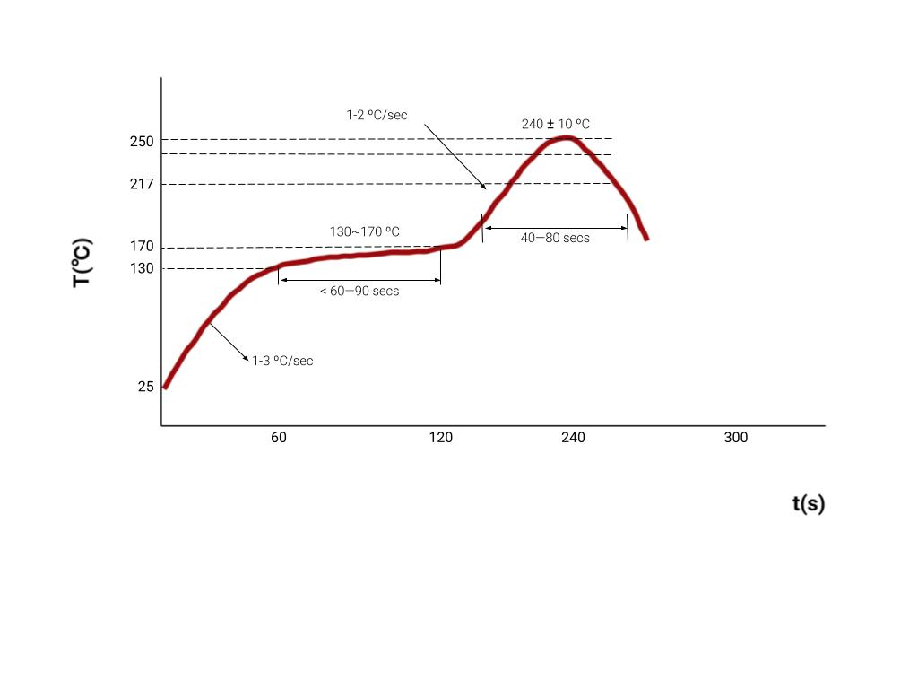
Application Notes:
You have a choice between two printing scraper materials, polyurethane with a hardness ranging from 80 to 90 Shore, or stainless steel. When it comes to scraper velocity, the sweet spot is within the range of 25 to 150 mm/sec.
Additionally, templates are available in various materials, including stainless steel, molybdenum, nickel, or brass. For optimal performance, maintain an operating temperature between 70 to 77°F (21-27°C) and humidity levels at 35-65% Relative Humidity (R.H.).
Cleaning:
This lead-free solder paste in this series is designed to eliminate the need for post-weld residue cleaning. When cleaning is necessary, residues from this solder paste series can be easily managed and addressed.
Recommended reflow process
Heating rate | Ramp to 120 ºC | Constant 30 - 170ºC | Peak | > 220°C | Cooling rate
1-3 ºC/sec | < 60—90 secs | 60—120 secs | < 245ºC ±5 | < 40—80 s | <4ºC / s
Recommended reflow soldering temperature

Slide 3
Features
Precise Printing Capability: Achieves exceptional tin liquidity, enabling fine printing even with a pad pitch as low as 0.3mm.
Consistent Viscosity: Demonstrates remarkable viscosity stability during continuous printing. Viscosity remains unchanged for extended periods, exceeding 8 hours, while consistently delivering high-quality printing results.
Shape Retention: Maintains its original shape for hours after printing, ensuring that printed graphics remain intact and do not affect surface-mounted components.
Excellent Weldability: Exhibits strong weldability and superior wettability on various substrate materials.
Versatile Equipment Compatibility: Suitable for a wide range of welding equipment, eliminating the need for a nitrogen-filled environment. It delivers excellent welding performance across a broad reflow oven temperature range, compatible with both "heating-temperature-controlled" and "gradual heating" furnace temperature profiles.
Minimal Residue: Leaves very little residue after soldering, resulting in light and well-insulated solder joints that do not corrode PCBs. Achieves one-time soldering requirements.
Enhanced AOI Performance: Provides improved performance during Automated Optical Inspection (AOI) tests, reducing false positives and negatives.
Effective BGA Soldering: Solves challenging issues related to BGA (Ball Grid Array) soldering, ensuring reliable and high-quality solder connections.
Storage and handling:
Store at a temp range of 2 - 8 °C. The solder paste has a shelf life of six months from the mfg date and it should be managed according to the First In, First Out (FIFO) principle.
Prior to opening the package, it is essential to allow the solder paste to reach room temperature, which is recommended to take approximately 4 hours. After opening, within a 48-hour period, maintain the paste at a temperature within the specified storage range. During the 12-hour window post-opening, the solder paste should remain on the reflow PCB board to allow for a pre-idle time of 100±20 minutes.
Cold storage may lead to component separation within the solder paste. Therefore, it is crucial to thoroughly stir the solder paste for 3 to 5 minutes to ensure proper mixing. Recommended stirring methods include automatic stirring for 3±0.5 minutes or manual stirring for 5±1 minute, with a mixer speed of 400 rpm for revolution and 100 rpm for rotation.
Avoid combining leftover solder paste with new paste in the same container.
When not in use, reseal the solder paste container securely. If the cap does not provide an adequate seal, replace it while ensuring the sealing liner is correctly positioned for maximum integrity.
Typical Package
500g/bottle

